Slide 1
Localizer –a language translation app
Shri Shankaracharya Institute of Professional Management & Technology, Raipur
Minor Project Report on
CSE 7th Semester
Department of Computer Science and Engineering,
Batch 2018-2022
Session July – Dec 2021
Presentation Date:
Project Group Members:
Suraksha Mandhan
Chahat Tekwani
Project Guide
Taniya Jain
(Professor, CSE Dept.)

Slide 2
Application Area
Motive :
To help people translate text from one language to another in just a click away, as translation helps a lot in easing out the communication between two person having different native origin.
Applications :
Translation helps in breaking language barriers by spreading information, ideas, and knowledge effectively with people in different countries.
End Users:
Anyone who wants to get help in translating text from a source language to his/her desired language.

Slide 3
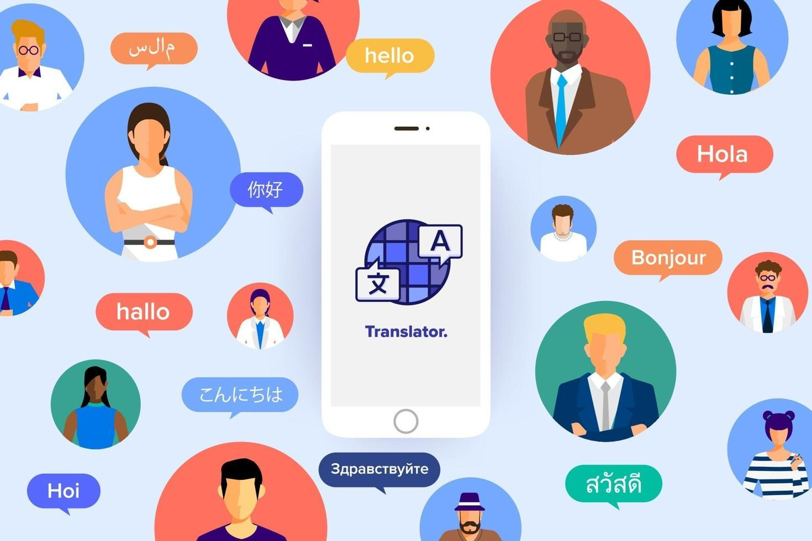
Project Overview
An Android App that can be used to translate English text into any other language (51 different languages) chosen by the user in a single click.

Slide 4
Project Requirements (Developer)
Software Required
VS Code
Android Studio
Docker Image
Azure Kubernetes Services
Hardware Required
Laptop/computer
Keyboard
Mouse
Wifi router for network connections.

Slide 5
Project Requirements (End User)
Software Required:
Anyone who wants to use he app can simply download and install the apk file of our app from below link.
Link - https://github.com/Suraksha-mandhan/Localizer-fe
Hardware Required:
Android phone with an Android OS version 4.0 and higher.

Slide 6

Back End Details
To integrate with a translation engine we used Microsoft Translation engine. Steps to integrate with the Microsoft Cognitive Services can be found here.
We chose node.js for developing the backend as it is quick to develop and provides us with asynchronous functionalities.
We used Express.js to expose the REST API’s.
The container has been deployed in Azure kubernetes service.
Github link: https://github.com/Suraksha-mandhan/Localizer

Slide 7
We have exposed two API’s:
API 1:
Path - /languages
Content-Type – “application/json”
Method - Http GET
Response – Map of all supported languages.
API 2:
Path - /translate
Content-Type – “application/json”
Method – Http POST
Request Body - { “text” : <text to translate>, “toLang”: <language of translation> }
Response – “The translated text in the requested language”.

Slide 8
Front End Details
The frontend has been developed in JAVA.
In order to integrate with the backend service we have used the Volley dependency library. More about Volley can be found here.
Github link: https://github.com/Suraksha-mandhan/Localizer-fe

Slide 9
Database Details
Not Applicable
Third party Integration hosted on cloud.

Slide 10
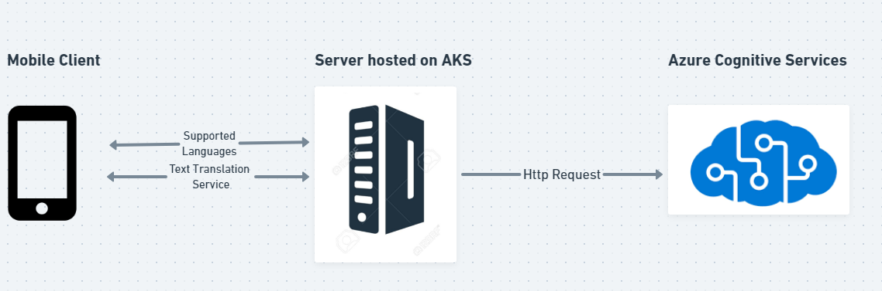
Project Flow Diagram

Slide 11
Data Flow Diagram
Azure
Kubernetes
Service
Backend API for translation
Translated text
(JSON object)
Localizer
-Android App
Response as text in the App
USER
Choosen Language &
text to convert

Slide 12
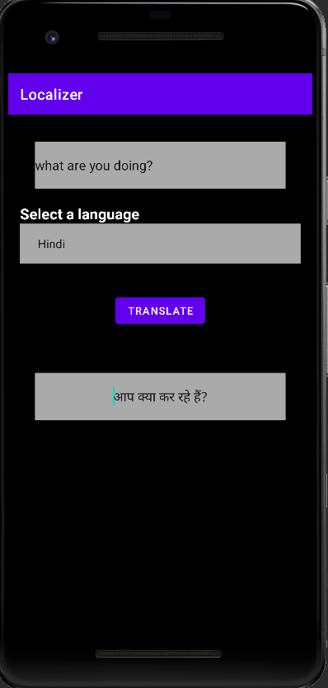
SNAPSHOT (GUI/INTERFACE)

Slide 13
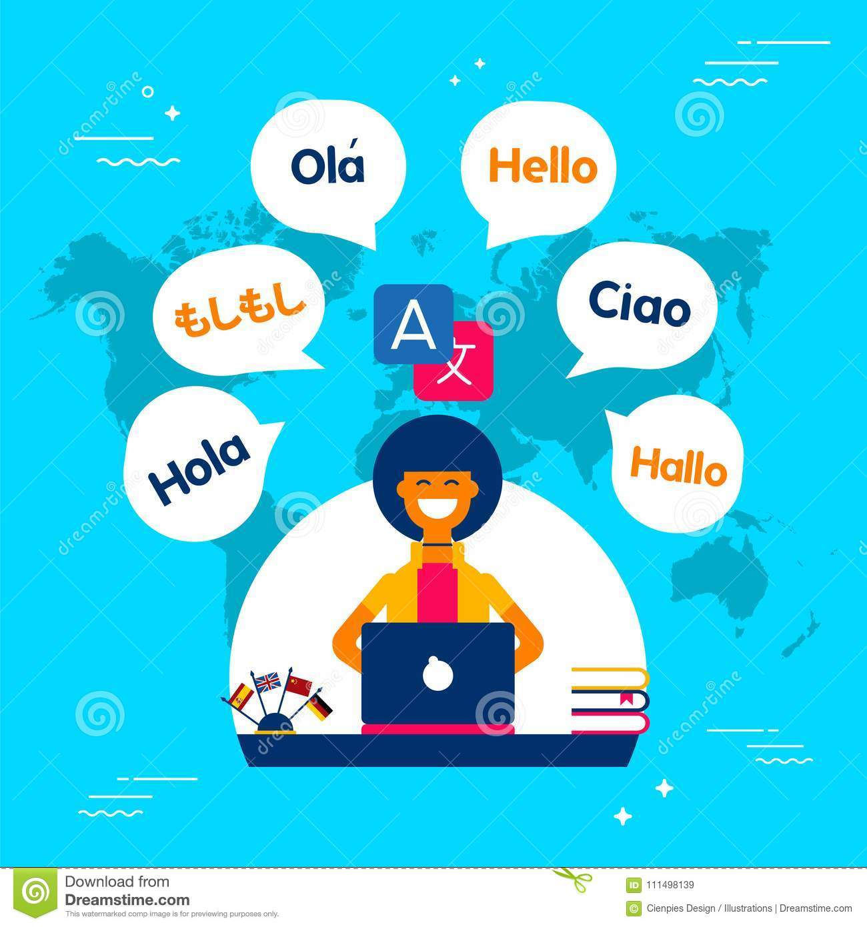
Result & Conclusion
Impact on society:
Using translation apps is an efficient way to eliminate language barriers and ensure communication between people who speak different languages.
Whether the communication is a simple message between friends or something more intricate, such as for conducting business or taking a trip abroad, there are many advantages to using a translation app.

Slide 14
References
Web Resources
https://developer.android.com/training/volley
(Client SDK to make REST Api calls)
https://docs.microsoft.com/en-in/azure/cognitive-services/translator/quickstart-translator?tabs=csharp
(Guide to setup Azure Microsoft Text Translator)

